Slide 1

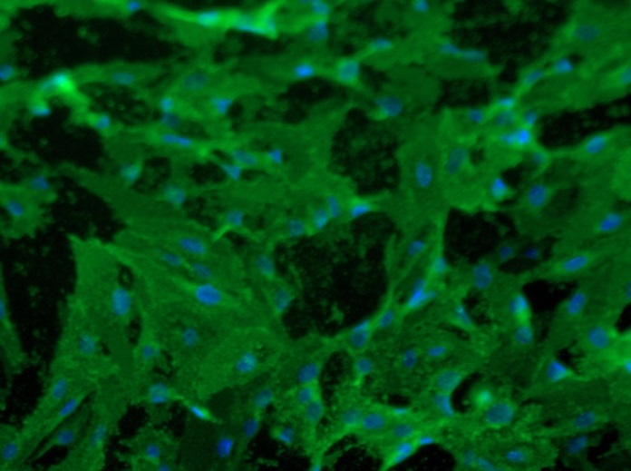
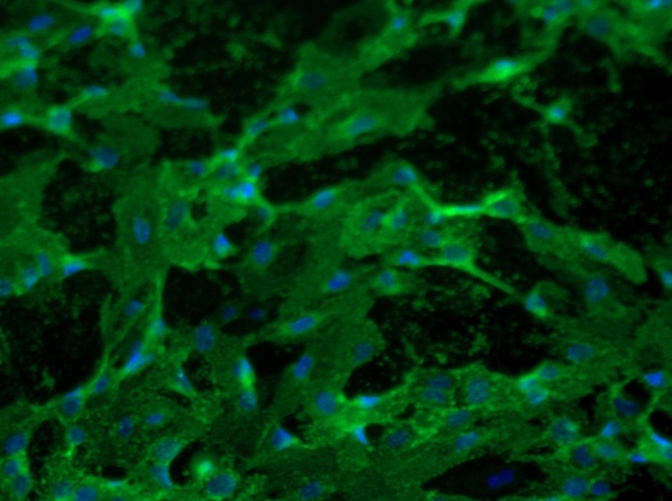
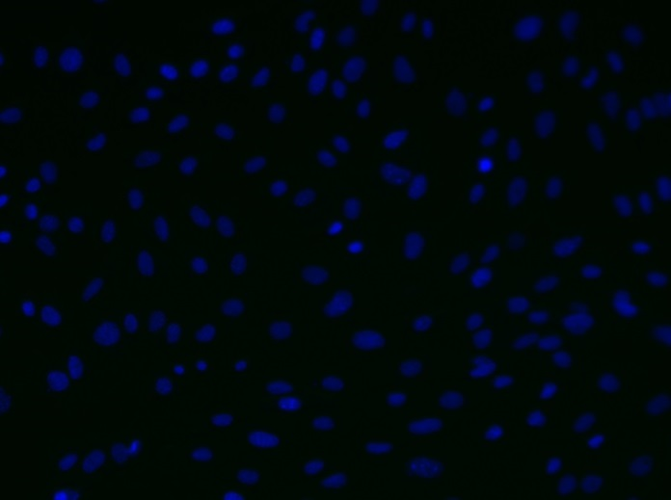
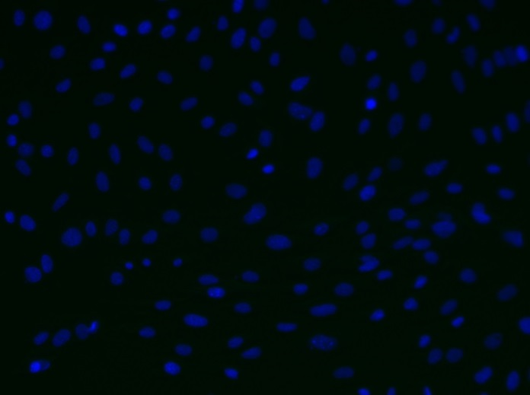
Reliatech GmbH
Rat anti-mouse LEC26
(Cat# 103-M152 [10 µg/ml]; SnoMec)
Immunofluorescence staining of mouse LEC26 antigen (#103-M152) in primary mouse endothelial cells (SnoMec) using a monoclonal antibody directed against with collagenase- and neuraminidase-treated mouse benign lymphangiomas .
As secondary antibody goat anti-rat ALEXA Flour 488 (Dianova; 1:600) was used.
[IF_mEC1407-01]
.
rat anti-mouse LEC26
rat anti-mouse LEC26
Control (goat anti-rat IgG ALEXA Flour 488; 1:400)
http://www.reliatech.de / orders@reliatech.de

